Slide 1
R (Basic)

Slide 2
R basic command
a=1
print(a)
b="Hello"
print(b)
a=c(1,2,4,5)
c = readline(prompt="Enter name: ")
sprintf("You have entered: %s", c)
e = 1
while (e<5) {
e=e+1
print(e)}
d = 1
if (d == 0)
{print("d is zero")} else if (d == 1)
{print("d is 1")} else
{print("d is not 0 or 1")}

Slide 3
R Analytics Example
dt = read.csv("C:/Users/Teoh Teik Teo/OneDrive - TSS Global Pte. Ltd/TT Library/AI Model/Data/DBS_SingDollar.csv") #alternatively read.csv
model=lm(dt$DBS ~ dt$SGD)
summary(model)
pred = predict(model)
err = dt$DBS - pred
rmse=(mean(err^2)^0.5)
print(rmse)
dt$SGD2 = dt$SGD^2
model=lm(dt$DBS ~ dt$SGD + dt$SGD2)
summary(model)
pred = predict(model, newdata = dt)
err=dt$DBS - pred
rmse = (mean(err^2)^0.5)
print(rmse)
plot(dt$SGD, dt$DBS, main="Regression", xlab = "SGD", ylab="DBS")
abline(model)

Slide 4
Optional

Slide 5
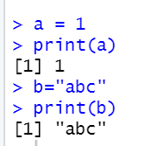
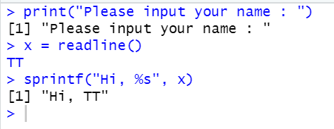
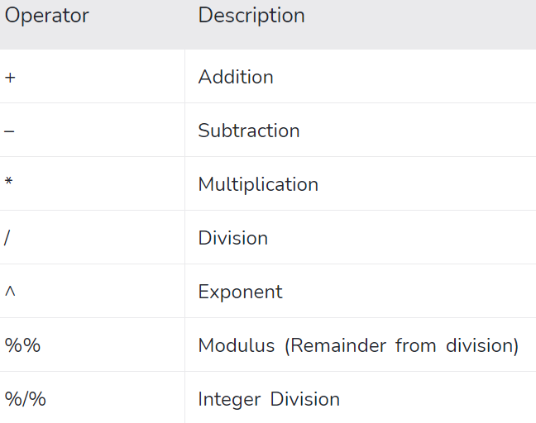
Python Simple Syntax (Variable, assign or input)
print("hello")

Slide 6
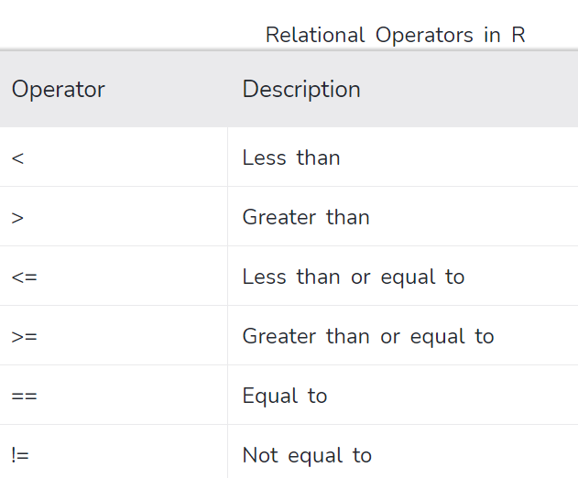
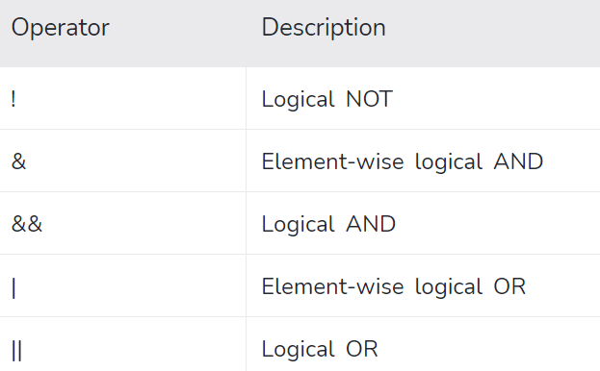
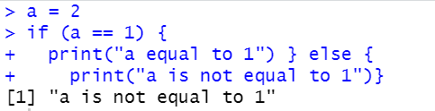
If else

Slide 7
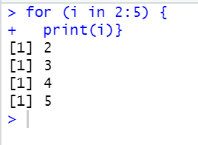
For Loop

Slide 8
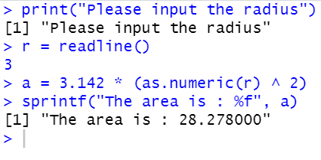
Simple task
Write a Python program which accepts the radius of a circle from the user and compute the area.

Slide 9
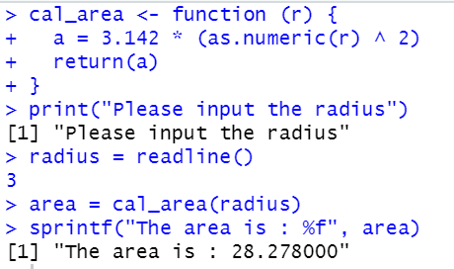
Using function

Slide 10
Read data using fread and split the data
library(data.table)
dt=fread("Treynor (Basic).csv")
library(caTools)
temp=sample.split(dt$Class, SplitRatio=0.3)
train=dt[!temp,]
test=dt[temp,]

Slide 11
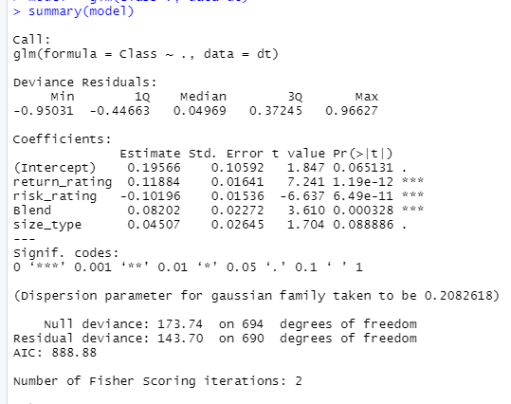
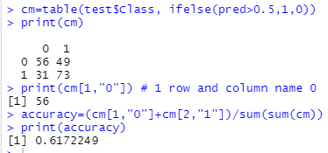
Logistic Regression
model = glm(Class~., data=train)
summary(model)
pred=predict(model, train)
print(pred)
cm=table(train$Class, ifelse(pred>0.5,1,0))
print(cm)
print(cm[1,"0"]) # 1 row and column name 0
accuracy=(cm[1,"0"]+cm[2,"1"])/sum(sum(cm))
print(accuracy)

Slide 12
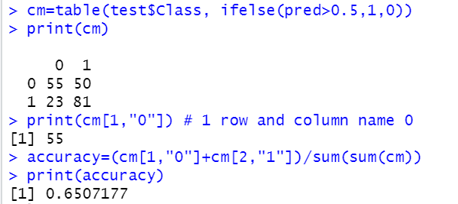
Logistic Regression – Test Set
pred=predict(model, test)
cm=table(test$Class, ifelse(pred>0.5,1,0))
print(cm)
print(cm[1,"0"]) # 1 row and column name 0
accuracy=(cm[1,"0"]+cm[2,"1"])/sum(sum(cm))
print(accuracy)

Slide 13
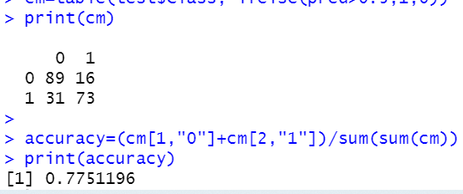
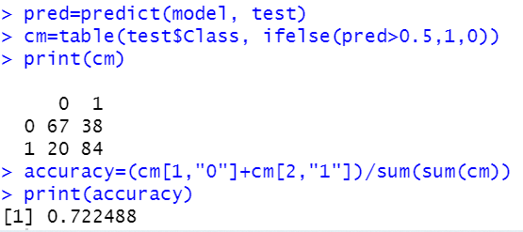
Decision Tree (Train + Test)
library(rpart)
model=rpart(Class~.,data=train)
pred=predict(model, train)
cm=table(train$Class, ifelse(pred>0.5,1,0))
print(cm)
accuracy=(cm[1,"0"]+cm[2,"1"])/sum(sum(cm))
print(accuracy)
pred=predict(model, test)
cm=table(test$Class, ifelse(pred>0.5,1,0))
print(cm)
accuracy=(cm[1,"0"]+cm[2,"1"])/sum(sum(cm))
print(accuracy)

Slide 14
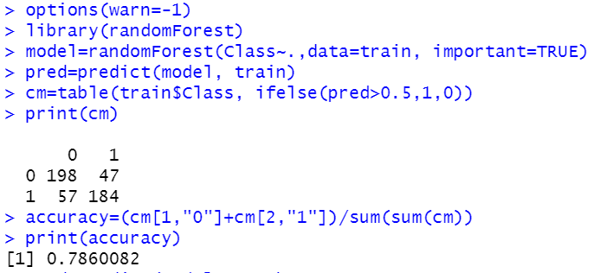
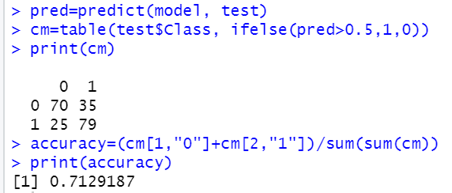
Random Forest
# install library randomForest
options(warn=-1) # remove any warning
library(randomForest)
model=randomForest(Class~.,data=train)
pred=predict(model, train)
cm=table(train$Class, ifelse(pred>0.5,1,0))
print(cm)
accuracy=(cm[1,"0"]+cm[2,"1"])/sum(sum(cm))
print(accuracy)
pred=predict(model, test)
cm=table(test$Class, ifelse(pred>0.5,1,0))
print(cm)
accuracy=(cm[1,"0"]+cm[2,"1"])/sum(sum(cm))
print(accuracy)

